Slide 1
AN INVESTIGATIONAL STUDY INTO THE DESIGN OF A LOW COST, ADAPTIVE HEARING AID
Presented by:
Kayla-Jade Butkow (714227)
Kelvin da Silva (835842)

Slide 2
Outline
Objectives and Specifications
System Block Diagram
Simulated vs Hardware Hearing Aid
Hearing Aid Functionality
Cost Breakdown
Results
Future Work and Conclusion

Slide 3
Objectives and Specifications
To develop a low cost hearing aid
Functionality:
Amplifying specific frequency bands according to a person’s audiogram
User tuneable directionality
Done in the form of:
Software simulation
Hardware proof of concept

Slide 4
System Block Diagram

Slide 5
Simulated vs Hardware Hearing Aid
Property | Simulation | Hardware
Number of microphones | 10 | 4
Device Bandwidth | 0.25–8 kHz | 2.8-3.5 kHz and 5.6-7 kHz
Filter Order | 14 | 2
Filter Bandwidth | 1/3 Octave | 1/3 Octave
Types of filters | Butterworth FIR bandpass | Butterworth bandpass
Number of filters | 16 per microphone | 2 per microphone
Number of steerable angles | 19 (10° increments) | 5 (0°, 60°, 90°, 120°, 180°)
Real time data acquisition | No | Yes

Slide 6
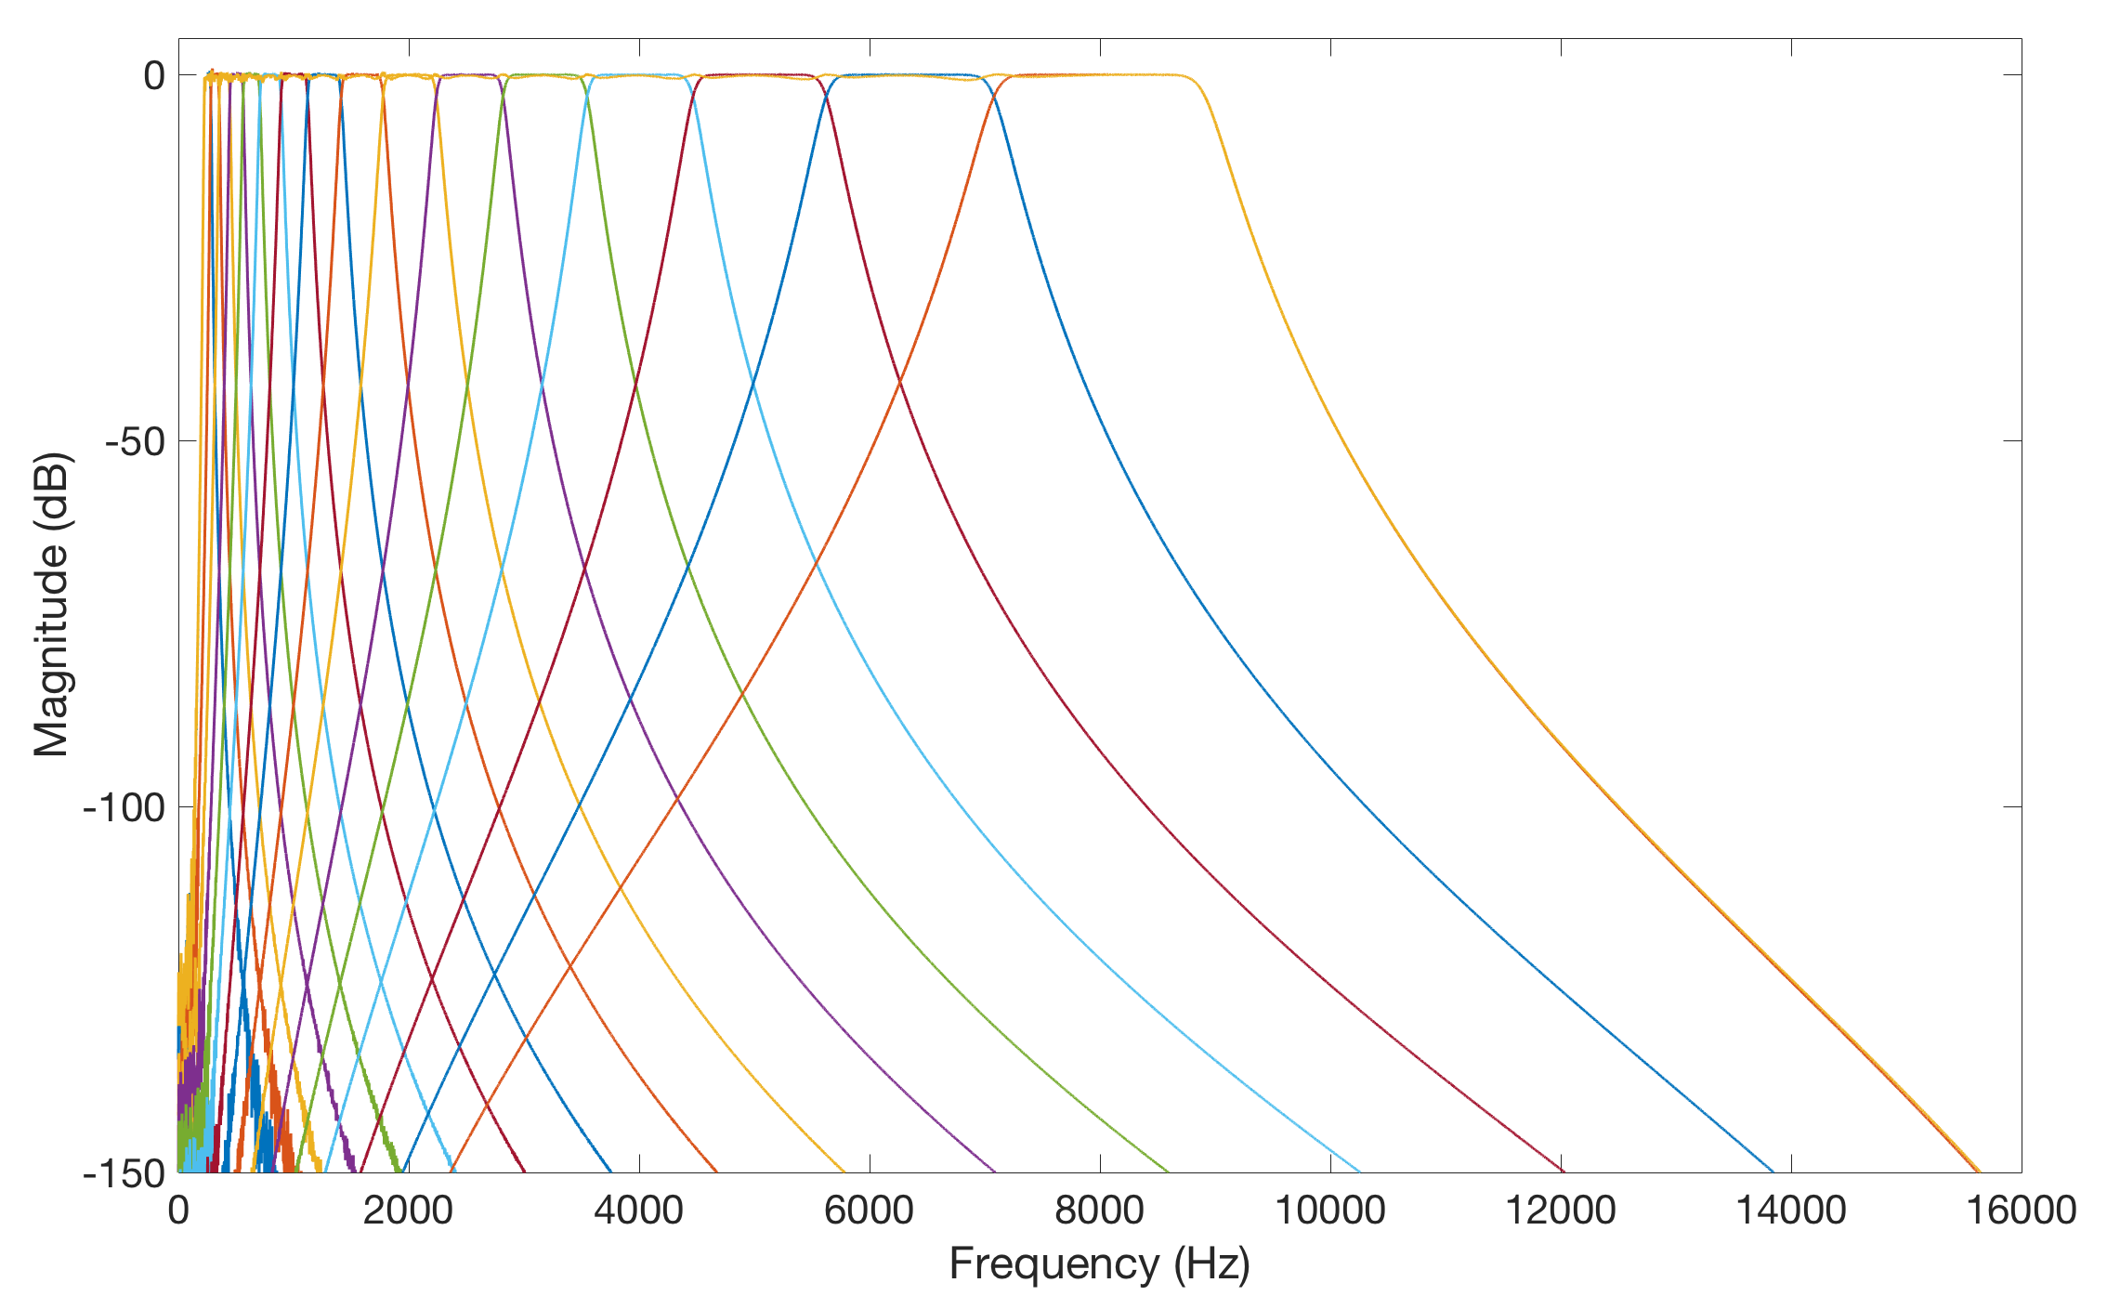
Compensatory Amplification
Audiogram matching: requires amplification of individual frequency bands
Notes:
Independent amplification
Band-by-band basis
Audiogram matching
Requires interpolation of audiogram
Unique for an individual

Slide 7
Directionality
Amplification in a user specified direction
Delay-and-sum beamforming
Adapted from [1]

Slide 8
Cost Breakdown
Component | Cost (R)
Arduino Due | 569.00
MAX9814 Microphone Amplifier x4 | 546.00
LM358 x5 | 16.05
LM386 | 15.75
Headphone Jack | 16.31
9V Battery | 70.00
Veroboard | 49.70
Headphones | 69.90
Casing | 59.90
Miscellanous | 50.00
Total | 1462.61

Slide 9
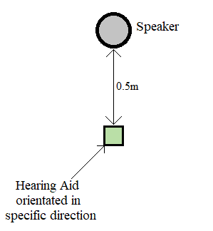
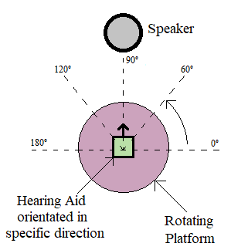
Testing
Compensatory gain
Directionality

Slide 10
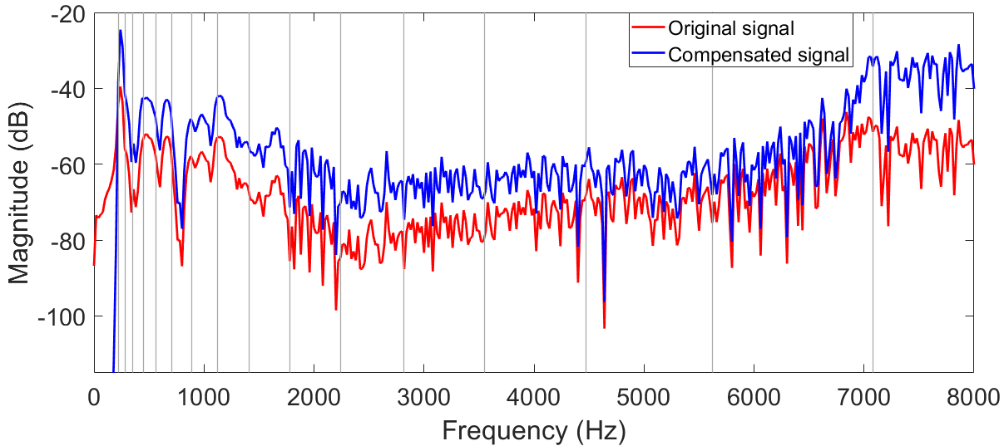
Results: Simulation
Matched to an audiogram
Average error per frequency band: 1.41%

Slide 11
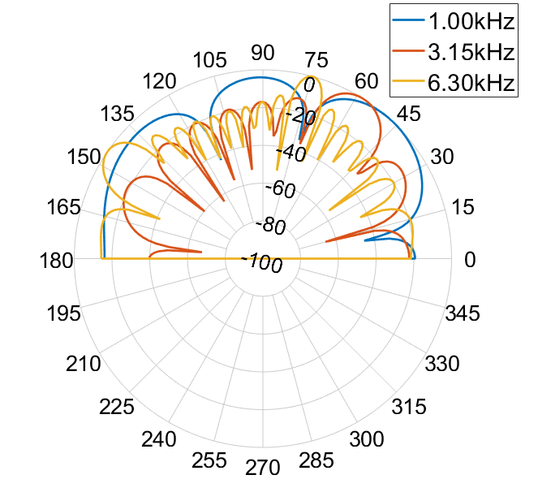
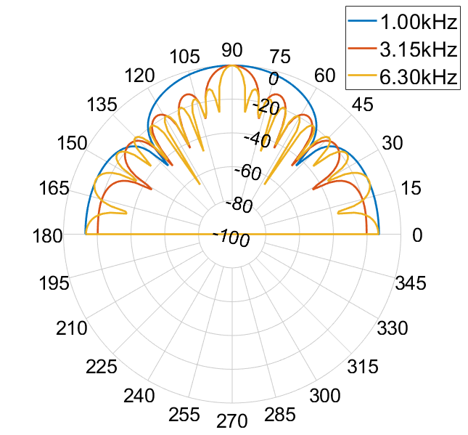
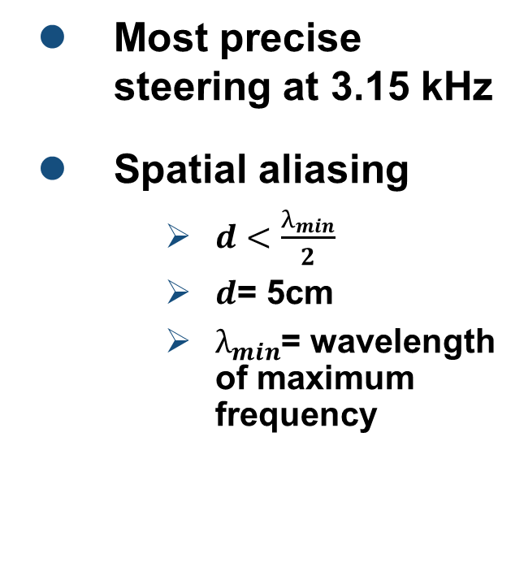
Results: Simulation
Most precise steering at 3.15 kHz
Spatial aliasing
$d<\frac{λ_{min}}{2}$
$d$= 5cm
$λ_{min}$= wavelength of maximum frequency
60°
90°

Slide 12
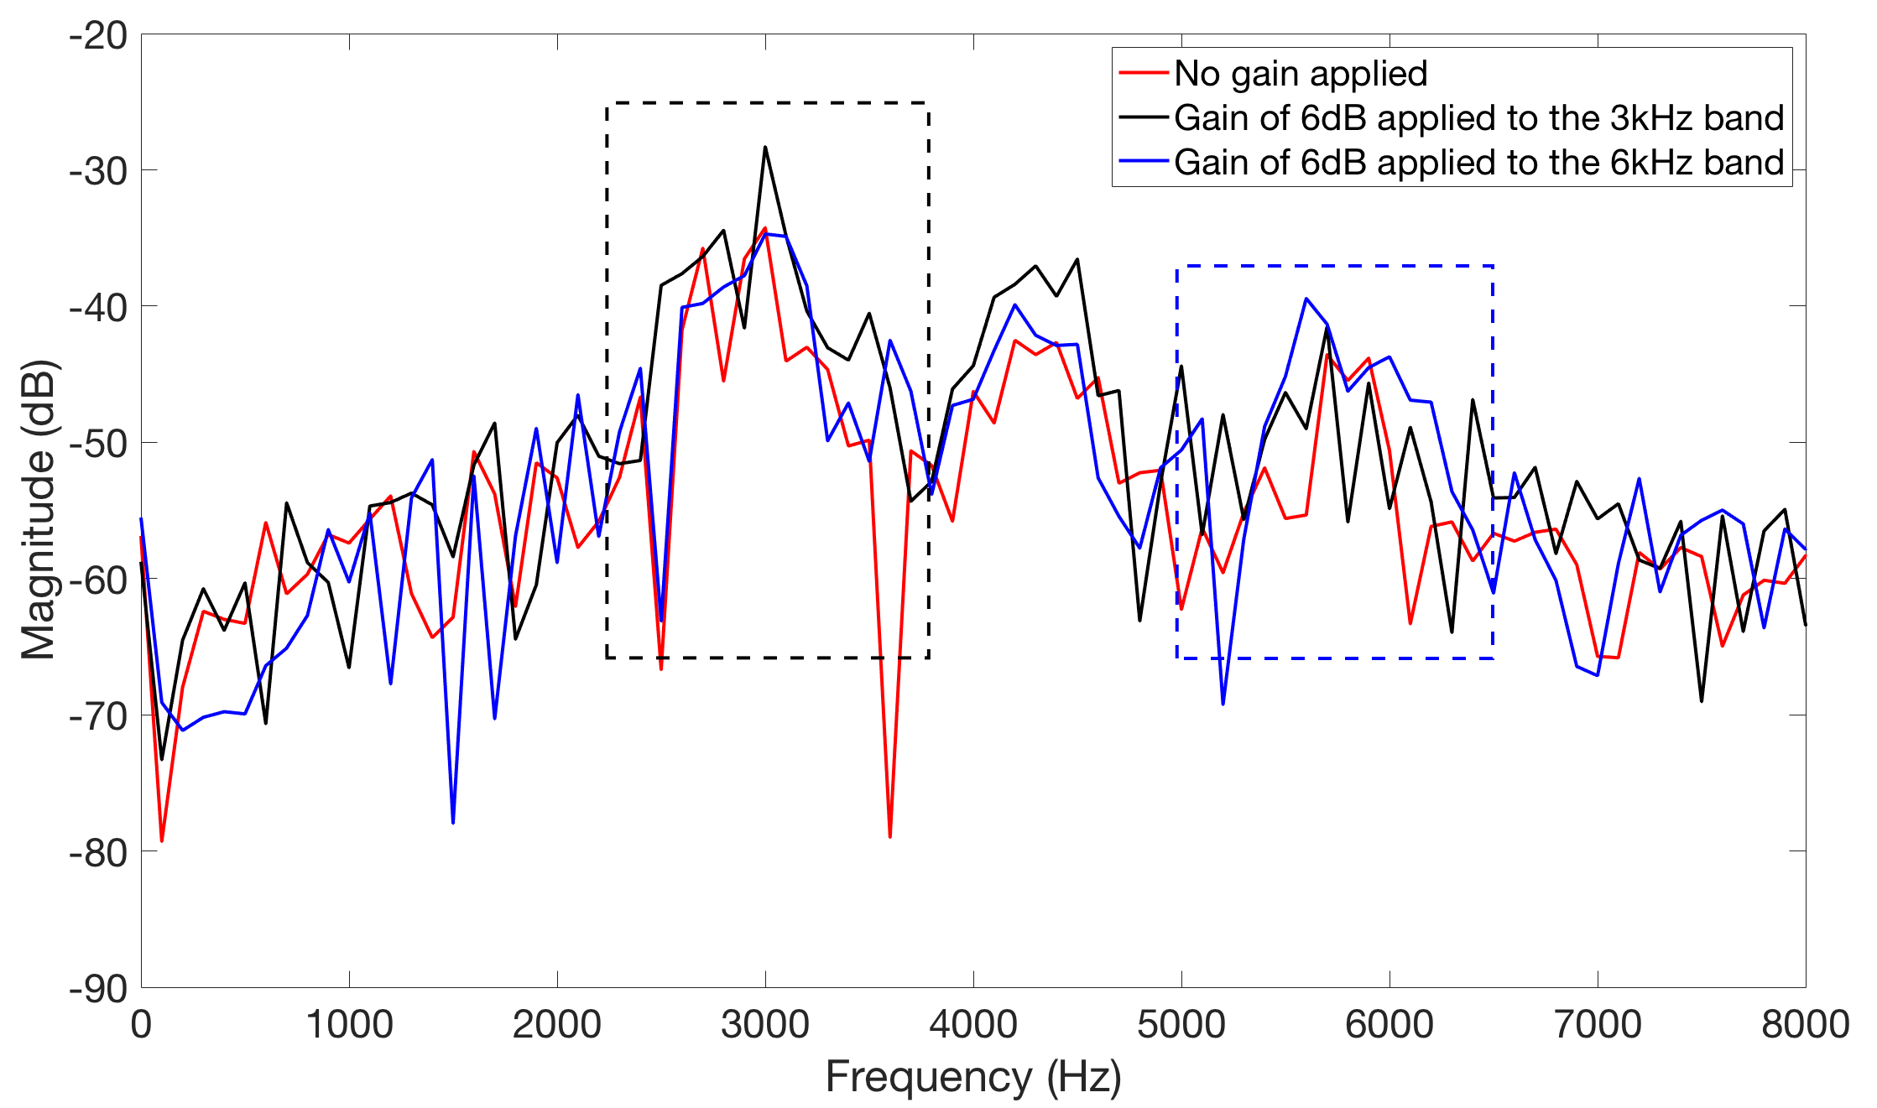
Results: Hardware
Input sound frequency: 3.15 kHz
Error caused by interaction of stop-bands
Due to filter order
Notes:
Effect of amplifying one band is seen across the frequency spectrum- due to the order of the filter

Slide 13
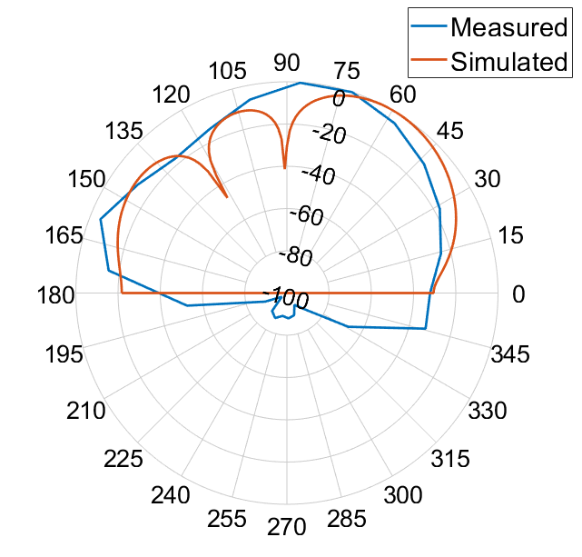
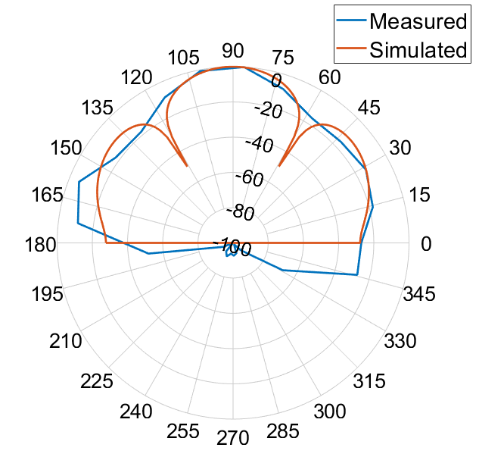
Results: Hardware
Most accurate at 90°
No time delay
Increased error in other directions
Integer number of sample shifts
Nulls not distinctive in measurements
60°
90°

Slide 14
System Error Analysis
Compensatory Amplification | Applied Frequency (kHz) | Frequency Band (kHz) | Error (%)
 | 3.15 | 2.82-3.55 | 0.81
 | 6.30 | 2.82-3.55 | 15.34
 | 3.15 | 5.62-7.08 | 19.56
 | 6.30 | 5.62-7.08 | 3.67
Directionality | Dial Angle (°) | Average Error (%)
 | 0 | 46.6
 | 60 | 30.7
 | 90 | 12.7
 | 120 | 22.7
 | 180 | 51.7
 | Omni-directional | 42.7
Notes:
Large omni error due to mics

Slide 15
Future Work
Higher quality omni-directional microphones
More microphones
Improve the precision of the beam steering
Integrated circuit chip
Preprocessing of the audio signals
Emdedding circuitry into headphones
Reduce the size of the device
Make the device more user friendly

Slide 16
Conclusion
Objectives and specifications have been met
Low cost – under R1500
Full hearing aid simulation
Compensatory amplification
Steerable directionality
Concepts proven in hardware

Slide 17
References
[1] L. Tiete et al. “Detecting Laterality and Nasality in Speech with the Use of a Multi-Channel recorder.” Sensors (Basel, Switzerland), vol. 14, pp. 1918-1949, 02 2014.

Slide 18
Questions?

